Slide 1
Financing
Scholarships, Bursaries, and Student Loans

Slide 2
Scholarships: Institutions
You are considered for entrance scholarships at most PSIs just by submitting your application. You can often get $500-$1500 if your average is over 80-85%.
Major scholarship deadlines are usually December 15. These scholarships are worth $5000-$20,000 and require lots of community/school/leadership involvement across all three years of high school in addition to excellent marks. These require a separate application and process.
Searching your PSI’s website is usually the best way to find these scholarships. Some, like SAIT, have program specific scholarships.

Slide 3
Scholarships: Searching Online
Top scholarship websites:
  Alis.alberta.ca
  Scholarshipscanada.com
  Studentawards.com
  Studentaid.alberta.ca
  CanLearn.ca

Slide 4
Scholarships: Close to Home
Where do your parents work?
Where do your grandparents work?
Any military service in family?
Any specific health issues – diabetes, hearing impaired, celiac, etc?
Where do you work?
What’s your heritage? FNMI, Polish, Chinese?
What are your hobbies?

Slide 5
Scholarship Application Tips
Be honest!
Brag about yourself.
Provide specific details and examples of your accomplishments.
Place emphasis on the skills/attributes you have acquired through your activities.
Get your reference letters early. References should not be people related to you.
Proofread for errors.

Slide 6
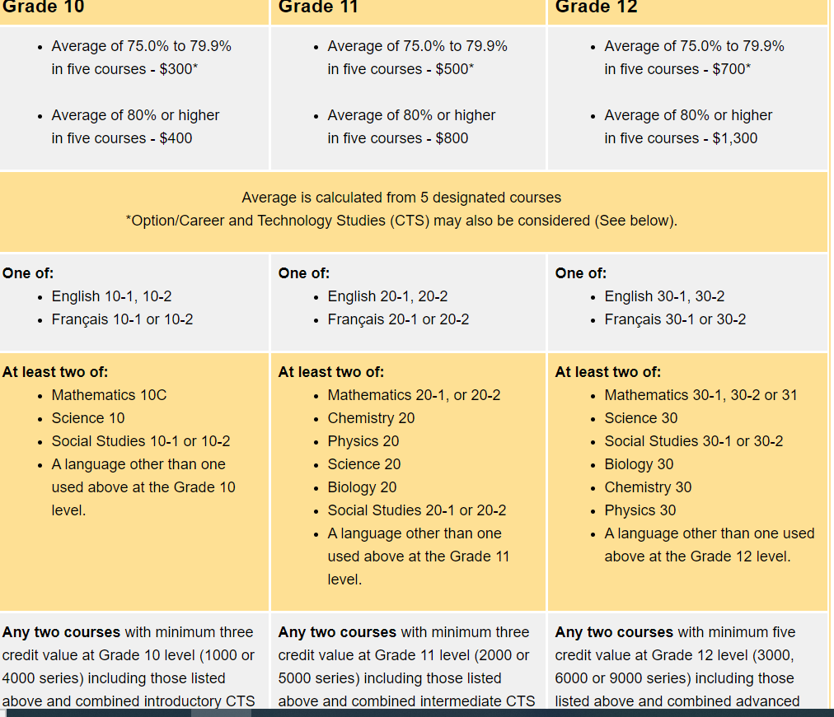
Alexander Rutherford Scholarship

Slide 7
Scholarship Application Tips
Begin your search now. Scholarship applications are like a part-time job. Start your search, check regularly, and keep a calendar of submission dates.
Have your applications ready at least 1 week ahead of due dates in case something goes wrong – unlike us, they don’t extend deadlines.
Any scholarships requiring an essay are less applied to so you have a better chance of winning these ones.
Don’t expect to get the $25,000 ones. Apply for several smaller ones and you can reach the same total.

Slide 8
Student Loans
Alberta Student Loans
  Assumed that you have saved $1500 each year you apply.
  No parental contributions expected or required.
  Studentaid.alberta.ca
  Applications open in July
  https://studentaid.alberta.ca/before-you-apply/what-you-contribute/

Slide 9
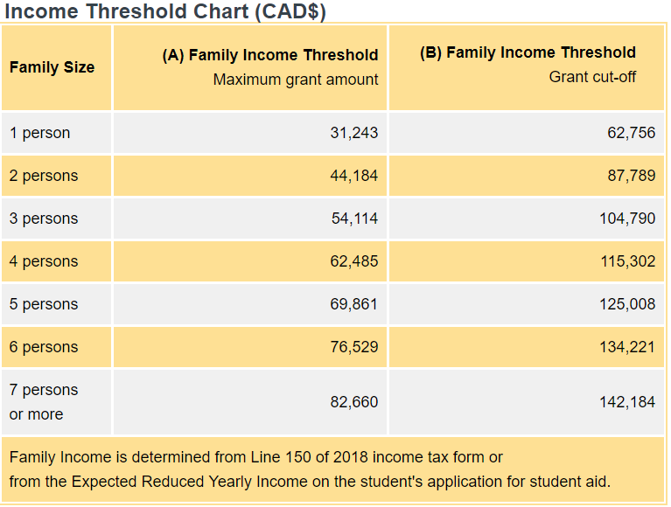
Student Loans
Canada Student Loans

Slide 10
Bursaries
Unlike student loans, no repayment is required.
Awards are based on financial need.
Personal and parental financial information is required.
Local: Carl Sorenson and Ellen E. Thompson

Slide 11
Grants
Alberta Student Loans no longer have grant money, but some Canada Student Loans still do.
Means no repayment on parts of the loan, often based on academic achievement or financial need.
Find other grants at studentaid.alberta.ca
  Low-income families
  Middle-income families
  Students with dependants
  Part-time students
  Students with permanent disabilities.

Slide 12
Working while at PSI
Heavier course load (5 classes per semester to graduate in 2-4 years typically, but varies based on school and program).
Try to have at least the 1st semester without work so you can adjust.
Working on campus or near where you live means less travel time and cost.
Work where you get extra benefits:
  Food and beverage
  Clothing discounts
  Free rent for managing a building
  Rent discount for landscaping, shovelling, cleaning, security, etc.

Slide 13
Beyond First Year
There are many, many opportunities after your first year, but you must search and apply.
Any volunteering you are able to do while at PSI will help your chances of receiving scholarships: charity work, coaching, tutoring, Student Union events, community volunteering – the possibilities are endless.
Most PSIs have student aid offices, often located in the Student Union Buildings – use their resources to help connect you to many financial opportunities.

