Slide 1
Graduating
How to get to the finish line

Slide 2
Presentation Topics and Dates
Graduating Friday, Sept. 18
Applying Thursday, Sept. 24
Financing Wednesday, Sept. 30
Parent Presentation Presentations will be available through the website in the Student Services tab.

Slide 3
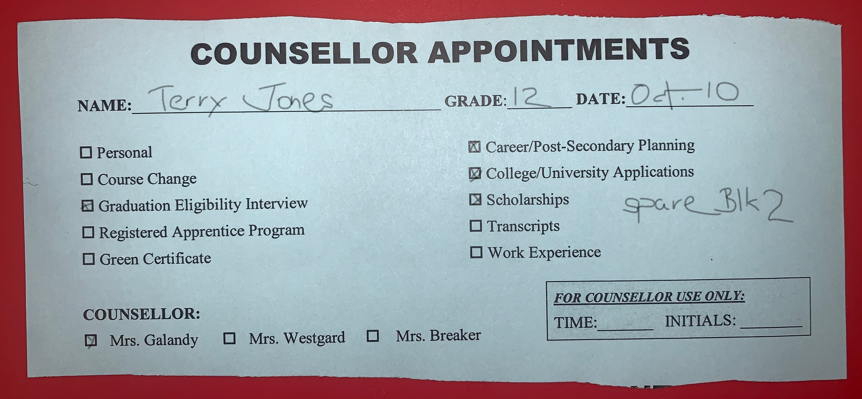
Grad Eligibility
Ms. Westgard and Mrs. Galandy will be meeting over the next 3 months with ALL grade 12s to discuss grad eligibility, future plans, and scholarship/bursary opportunities.
Please fill out the following form which will be given to you by your LS teacher on September 30. Complete the form and drop it in the box outside of Student Services. We will begin appointments on Oct. 2. Please be patient as there are many of you and only 2 of us! These presentations will help you get started before your meeting.

Slide 4
Communication
We will email you the date and time of your appointment to your GHSD email account the day before your appointment.
We try to book during your spares (if you have one), so please remain at the school on the day of your appointment.
If you don’t have a spare, please include the name of the class you would prefer to be called out of and we will do our best.
If you miss, please email to reschedule.

Slide 5
Alberta High School Diploma REquirements
English at the 30 level (30-1 or 30-2)
Social Studies at the 30 level (30-1 or 30-2)
10 credits in “other” 30 level courses (ie. Bio 30, Math 30-2, Art 30, PE 30, or 3000level CTS modules)
Math at the 20 level (20-1, 20-2, 20-3)
Science at the 20 level (Bio20, Chem 20, Phys 20, Science 24)
PE 10 (3 or 5 credit)
CALM 20
10 credits in CTS, a second language, PE 20 or 30, or Fine Arts
100 credits

Slide 6
…and SHS-Specific Requirements
105 credits to participate in Recognition Ceremonies (Grad) – to give you a buffer.
6 of 8 blocks in your timetable filled (or 3 of 4 blocks if you are here for only 1 semester)
If you have a split program (with another school ie. Learning Academy) you must take at least 2 core courses in the grade 12 year at SHS.

Slide 7
K & E Certificate of achievement
English 30-4
Social Studies 20-4
Science 20-4
Math 20-4
PE 10 (3 or 5 credit)
CALM 20
K & E Work Experience 30-4
13 other optional credits (CTS, Fine Arts, PE, Languages)
80 credits

Slide 8
MYPass
Alberta Education Website
Collects all of your educational information – credits, marks, schools attended in Alberta
Provides reports of this information to you and/or post-secondary institutions or employers – Detailed Academic Report, Transcript, High School Diploma
Diploma Exam Marks

Slide 9
Mypass homepage

Slide 10
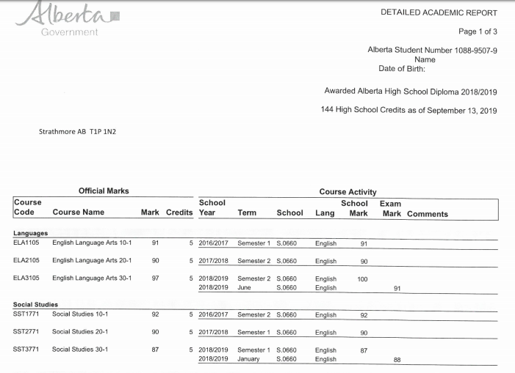
Detailed Academic Report (DAR)
Informal transcript – record of courses, marks, credits and schools.

Slide 11
Diploma Exam Results Statement

Slide 12
What if I have no plans?
DON’T PANIC!!
You are normal.
But it’s time to start purposefully exploring your options.
It’s OK to not know your “end-game”, but we want to have plans in place for next year so you feel like you are intentionally and purposefully moving on.

Slide 13
myblueprint
https://core.myblueprint.ca/V5/Spectrum

